Slide 1



SUPER MARIO
Home
About
Contact
FINAL PROJECT OOP
Mario is a cheerful plumber and Nintendo's iconic character, famous for his adventures rescuing princesses and overcoming thrilling challenges.

Slide 2


Home
About
Contact
SUPER MARIO
FINAL PROJECT OOP
Mario is a cheerful plumber and Nintendo's iconic character, famous for his adventures rescuing princesses and overcoming thrilling challenges.
SUPER MARIO
Slide
1

Slide 3
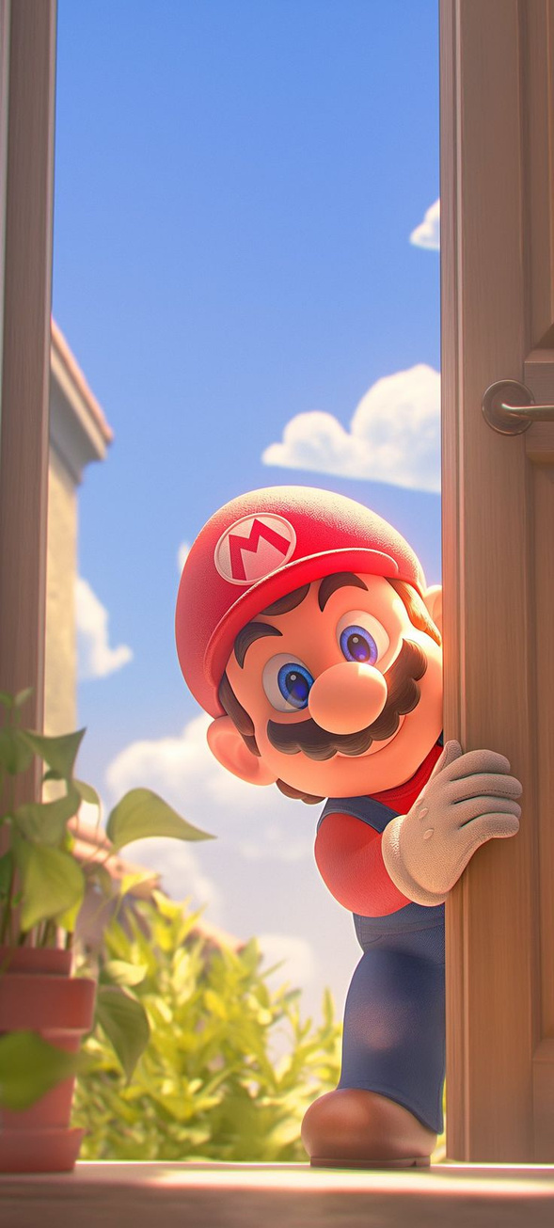





SUPER MARIO
Meet Our Team
Mario is a cheerful plumber and Nintendo's iconic character, famous for his adventures rescuing princesses and overcoming thrilling challenges.
Home
About
Contact
Home
About
Contact
Welcome to Mario
FINAL PROJECT OOP
Mario is one of the most classic and iconic video games in history, developed by Nintendo. The game revolves around Mario, a brave plumber who often teams up with his brother Luigi on a journey to rescue Princess Peach from Bowser, the king of the evil turtles.
SUPER MARIO
Slide
2
SUPER MARIO
TAN KHANH
QUANG HUY
HOANG KHANH
TRUNG KIEN
(ITCSIU23014)
(ITDSIU23038)
(ITCSIU23013)
(ITCSIU23020)

Slide 4

SUPER MARIO
Meet Our Team
TAN KHANH
QUANG HUY
HOANG KHANH
TRUNG KIEN
(ITCSIU23014)
(ITDSIU23038)
(ITCSIU23013)
(ITCSIU23020)
UML and Project structure.
Load game and menu.
Load level data, enemies and player.
Player functions, Keyboard and Mouse input.

Slide 5

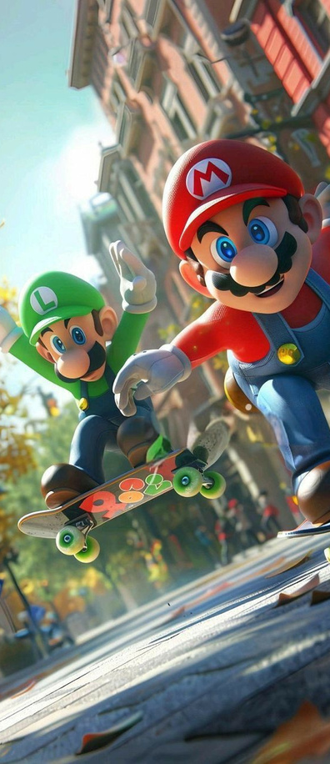

CONTENTS
UML and Project structure.
Load level data, enemies and player.
Collision and gravity
Demo

Slide 6
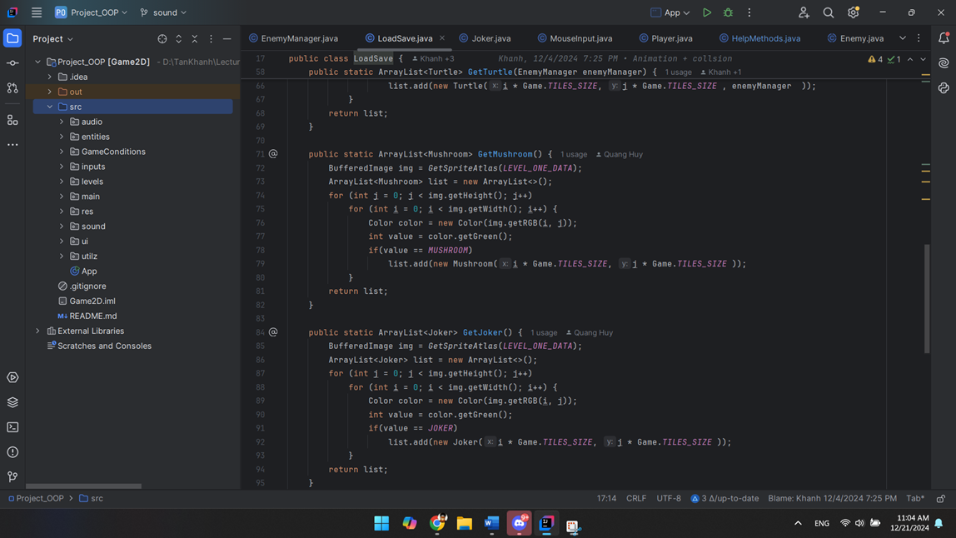
PROJECT - STRUCTURE
SUPER MARIO

Slide 7
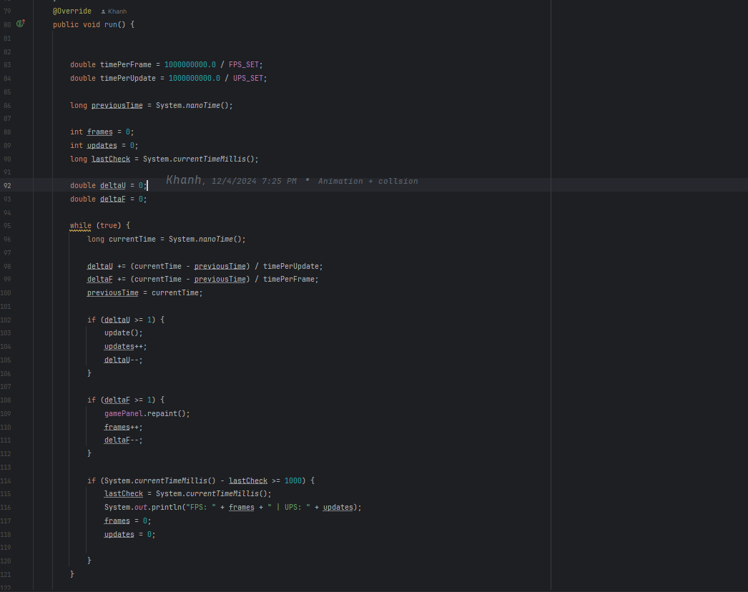
GAME LOOP
FPS SET (Frames Per Second):
Controls how often the game is rendered (visual updates).
In your code, it is set to 120, meaning the game tries to render 120 frames per second.
UPS SET (Updates Per Second):
Controls how often the game updates its logic (e.g., player movement, physics, etc.).
Set to 200, meaning the game state is updated 200 times per second.
SUPER MARIO

Slide 8
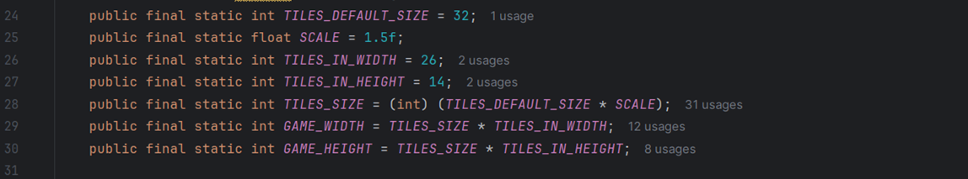
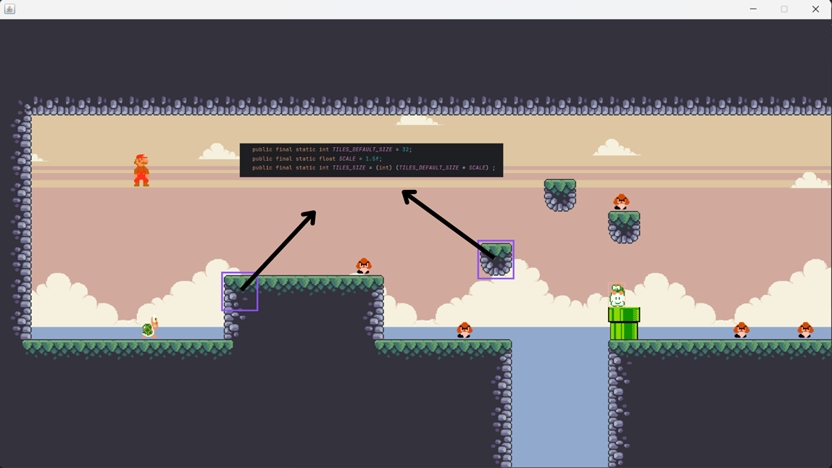
LEVEL DATA - GAME CONSTANT
Our game map is divided into equal tiles, each with a default size of 32px x 32px
26 tiles in width and 14 tiles in height
SUPER MARIO

Slide 9
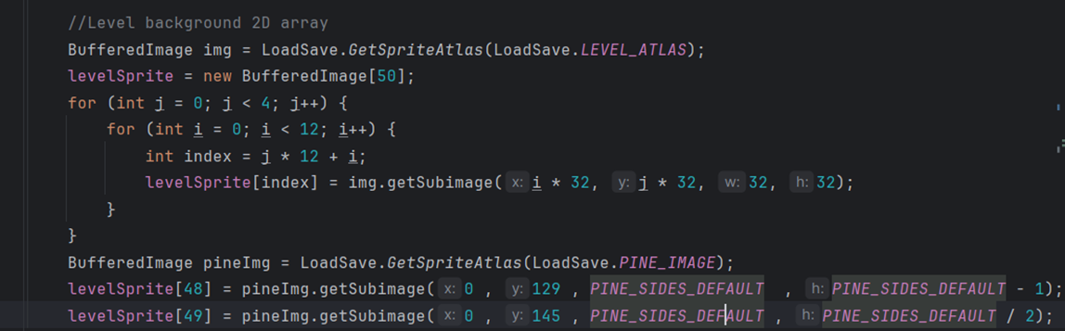
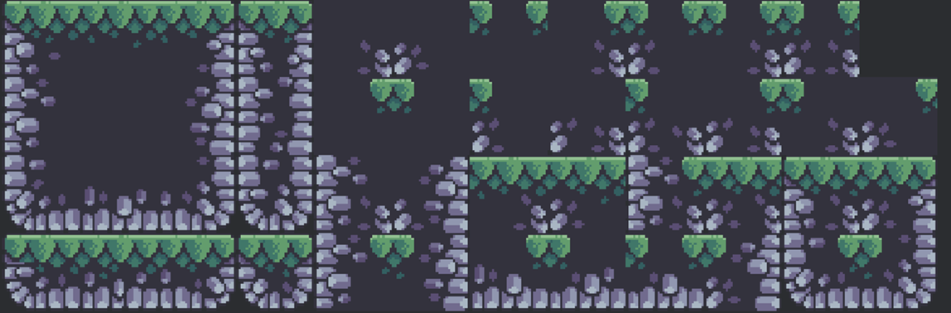
The nested loop extracts smaller sprites (32x32 pixels each) from the sprite atlas and stores them in the levelSprite array
LEVEL DATA - LOAD
SUPER MARIO
the levelSprite array

Slide 10
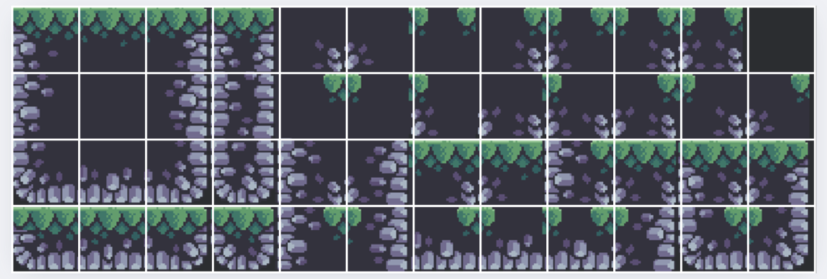
LEVEL DATA - LOAD
The nested loop extracts smaller sprites (32x32 pixels each) from the sprite atlas and stores them in the levelSprite array
the levelSprite array
SUPER MARIO

Slide 11
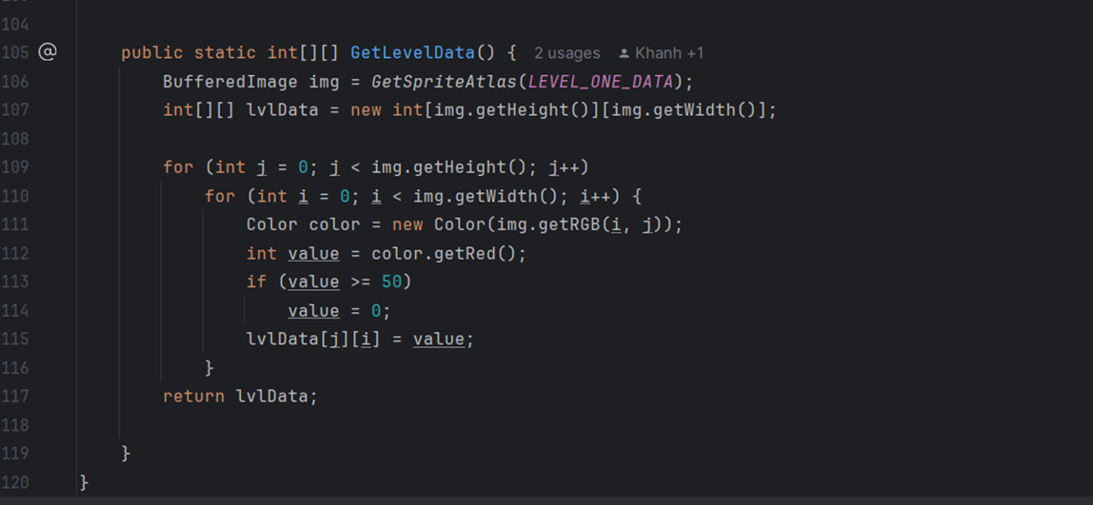
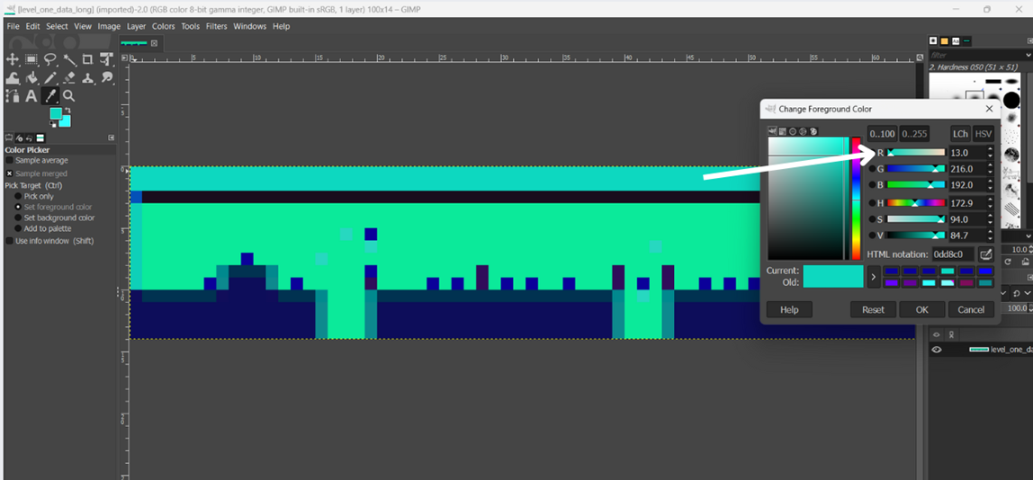
LEVEL DATA - LOAD
For each block, we assign the red color value of the corresponding pixel to the specific index in the levelSprite array where we want to draw the block.
0
1
2
3
SUPER MARIO

Slide 12
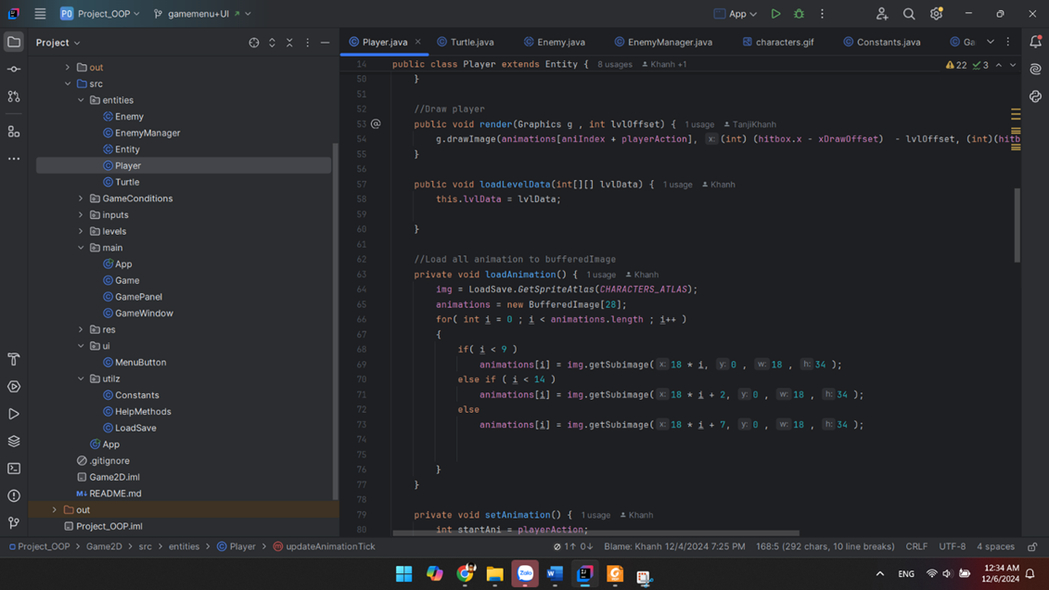
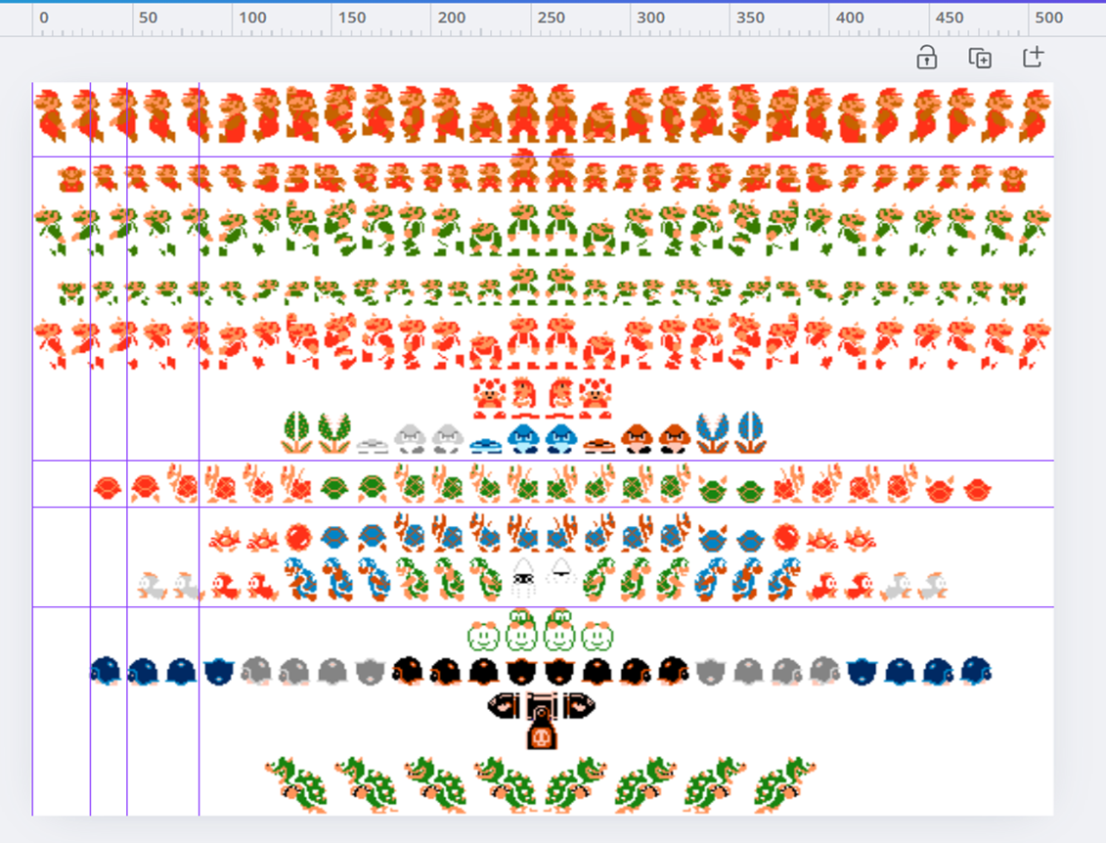
MARIO ANIMATION
SUPER MARIO

Slide 13
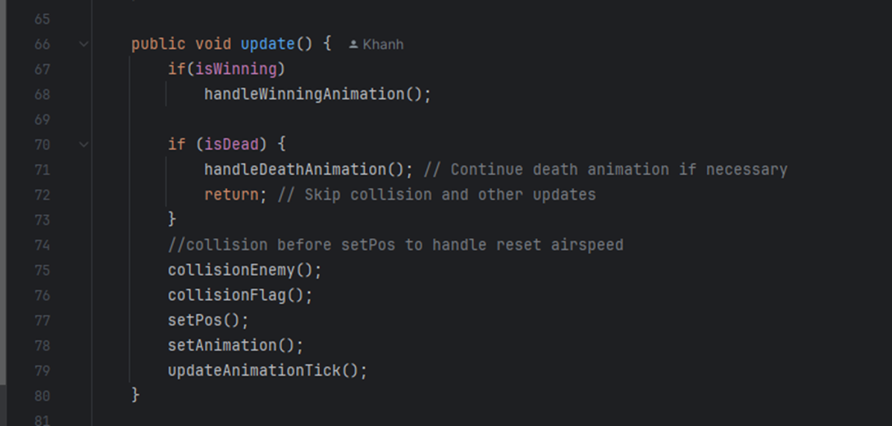
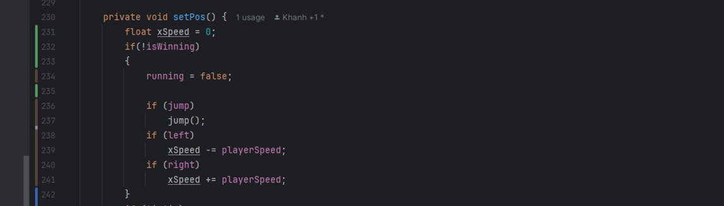
MARIO ANIMATION
SUPER MARIO

Slide 14
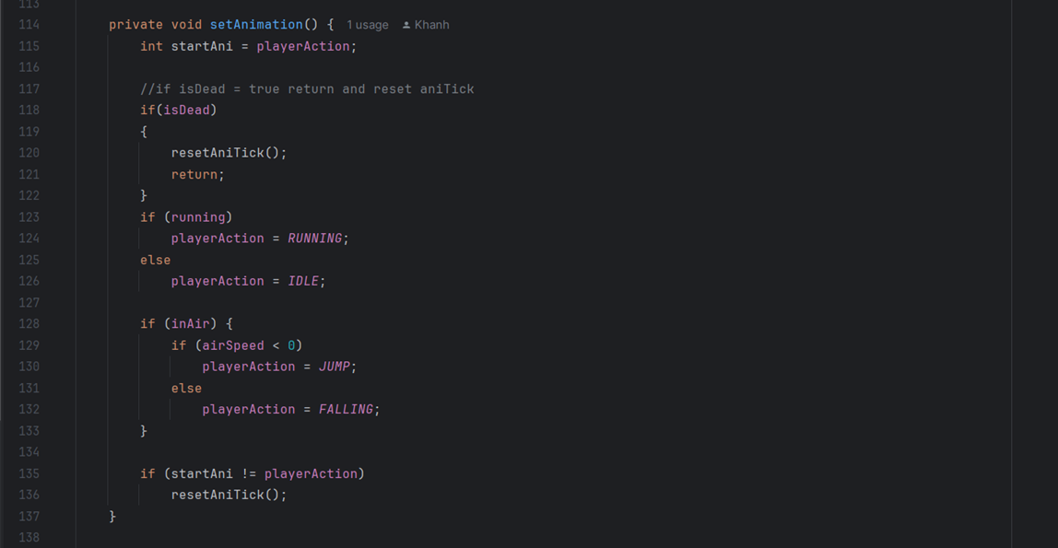
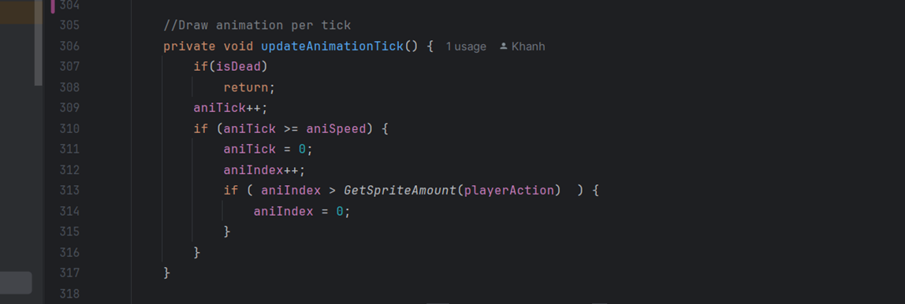
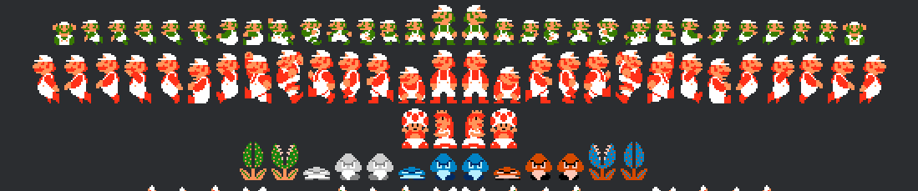
MARIO ANIMATION
RUNNING and IDLE store the position of specific animation in the animation array bufferImage. constant variable
GetSpriteAmount funcion is return how many frame of animation that action have.
SUPER MARIO

Slide 15
MARIO ANIMATION
RUNNING and IDLE store the position of specific animation in the animation array bufferImage. constant variable
GetSpriteAmount funcion is return how many frame of animation that action have.
SUPER MARIO

Slide 16
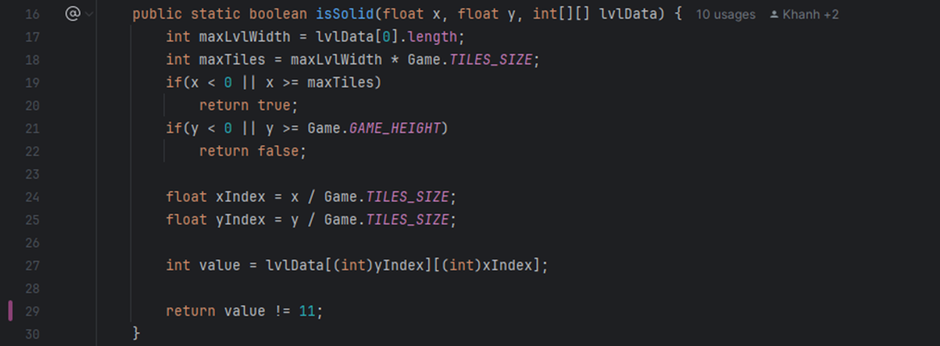
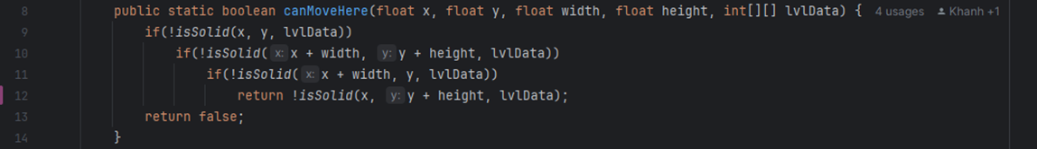
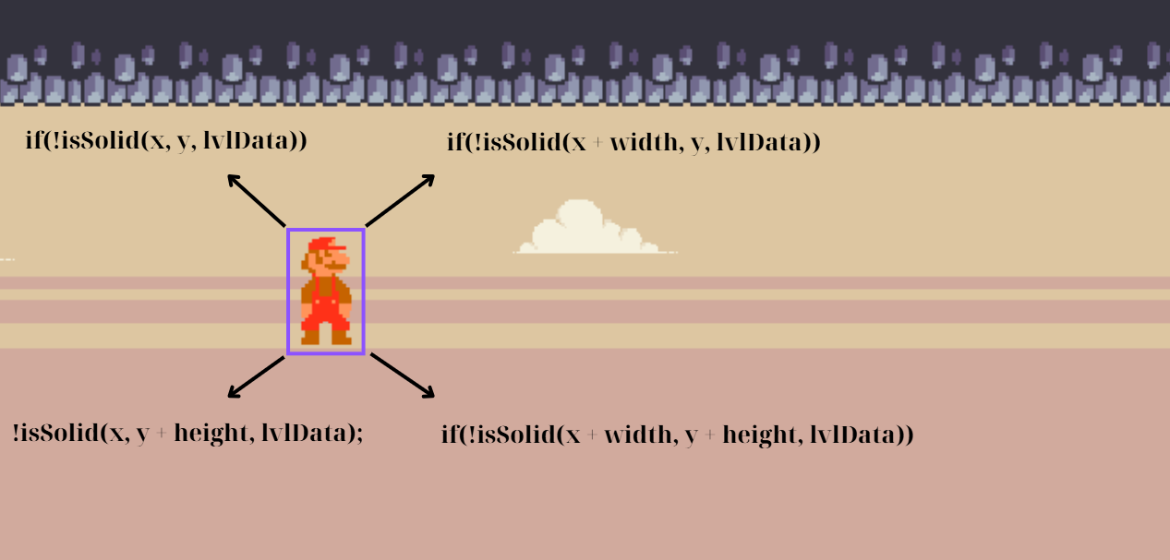
COLLISION
SUPER MARIO

Slide 17
COLLISION
SUPER MARIO

Slide 18
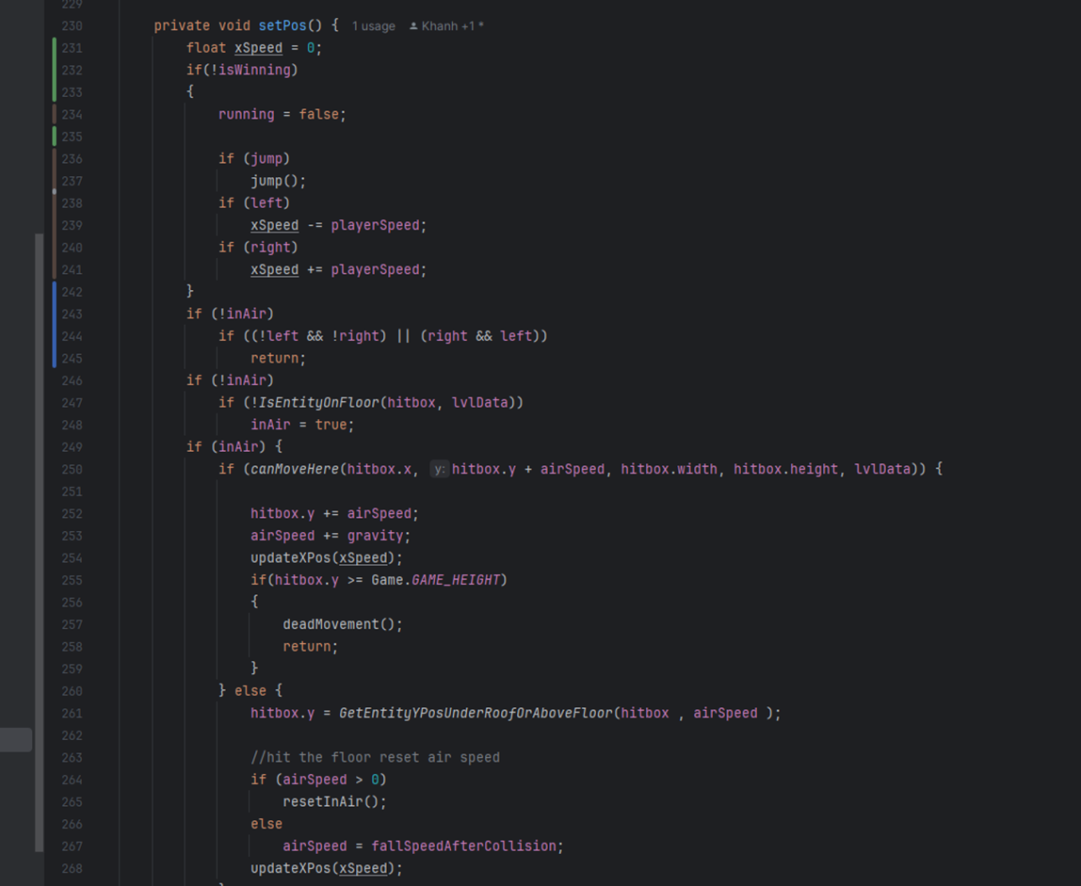
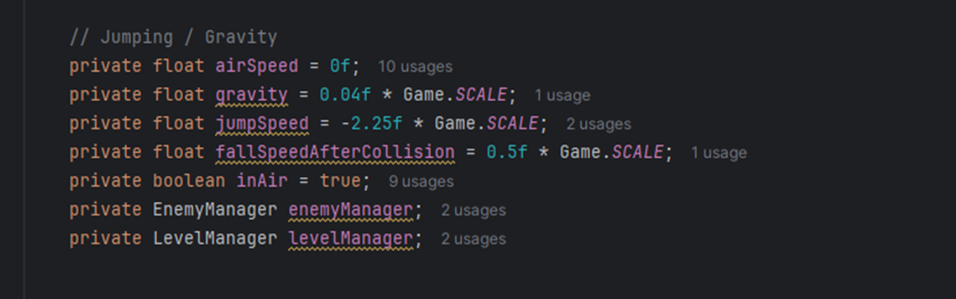
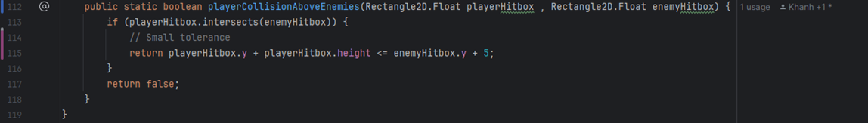
Gravity
If the player is not already airborne (inAir = false), the function checks whether the player is on the ground using IsEntityOnFloor. If not, the player enters the airborne state (inAir = true)
When airborne, the function:
Check if the player can move to the next vertical position (canMoveHere).
If movement is possible:
Updates the hitbox.y position based on airSpeed.
Increments airSpeed by gravity to simulate acceleration.
SUPER MARIO

Slide 19
If the player is not already airborne (inAir = false), the function checks whether the player is on the ground using IsEntityOnFloor. If not, the player enters the airborne state (inAir = true).
When airborne, the function:
Check if the player can move to the next vertical position (canMoveHere).
If movement is possible:
Updates the hitbox.y position based on airSpeed.
Increments airSpeed by gravity to simulate acceleration.

Slide 20
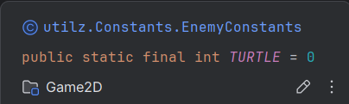
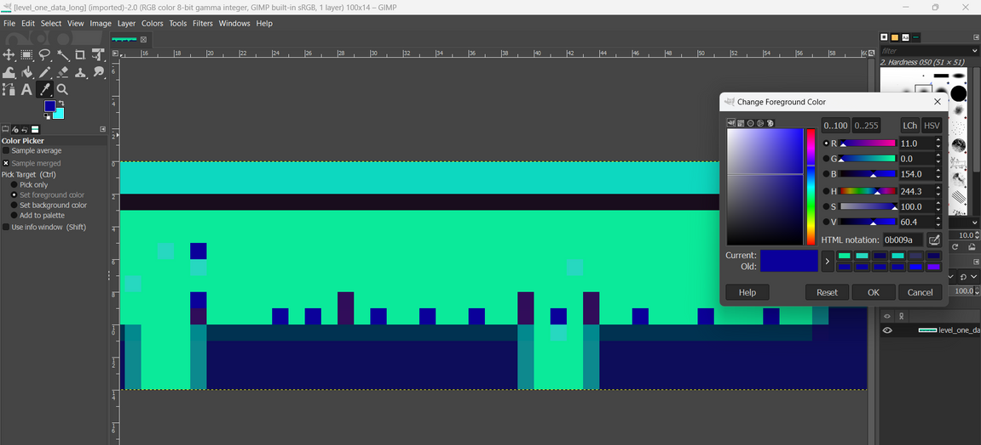
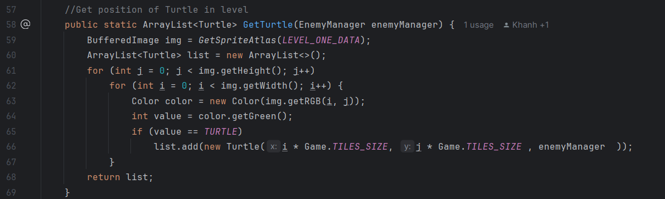
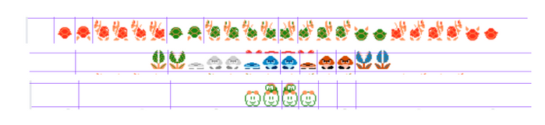
Enemies Animations
Load the level data image using the GetSpriteAtlas method
Iterate through each pixel in the image
Create a Mushroom object at the position derived from the pixel's coordinates
Add the Mushroom object to the list

Slide 21
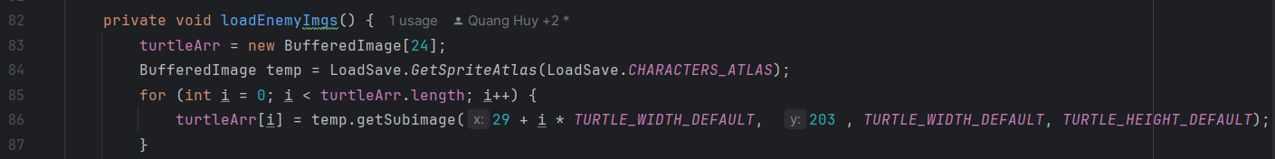
How to load Enemies and draw Image of each type
Load Enemies’ Image
iterates through each frame for a given enemy type
iterates through each frame for a given enemy type
Stores each frame in the corresponding array (turtleArr, mushroomArr, jokerArr)
SUPER MARIO

Slide 22
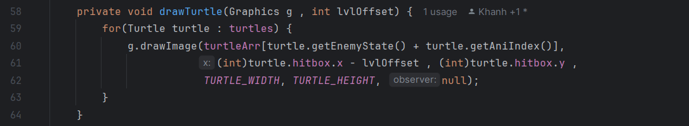
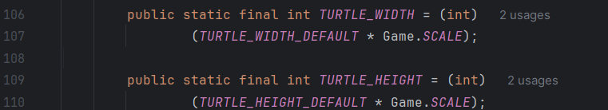
How to load Enemies and draw Image of each type
Draw enemies' image
1. Choosing the correct sprite for the current animation frame and state.
2. Positioning the sprite based on the Enemies's position (hitbox.x, hitbox.y).
SUPER MARIO
3. Scaling the sprite to the correct width and height.

Slide 23
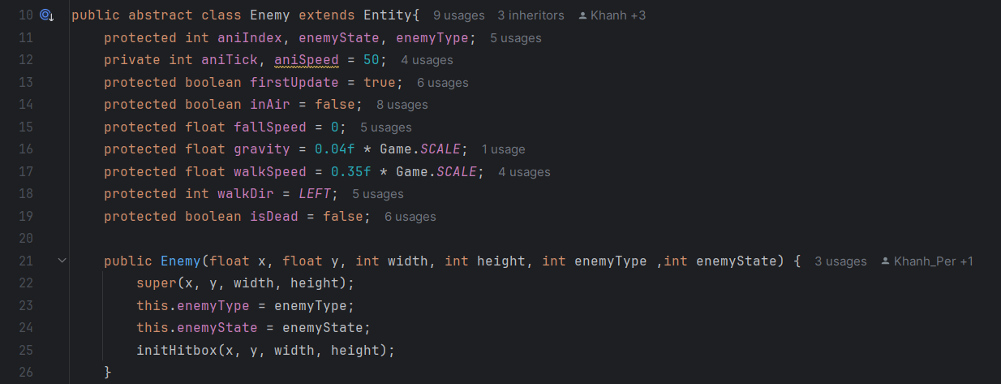
Why enemy is the abstract class?.
Enemy class is an abstract class, because it represents a base template for all enemy types in the game. It contains common properties and methods shared by all enemies, including movement, etc.
updateMove(int[][] lvlData):
abstract method for enemy-specific movement logic. Each enemy type (e.g., Turtle, Mushroom, Joker) must implement this method.
SUPER MARIO

Slide 24
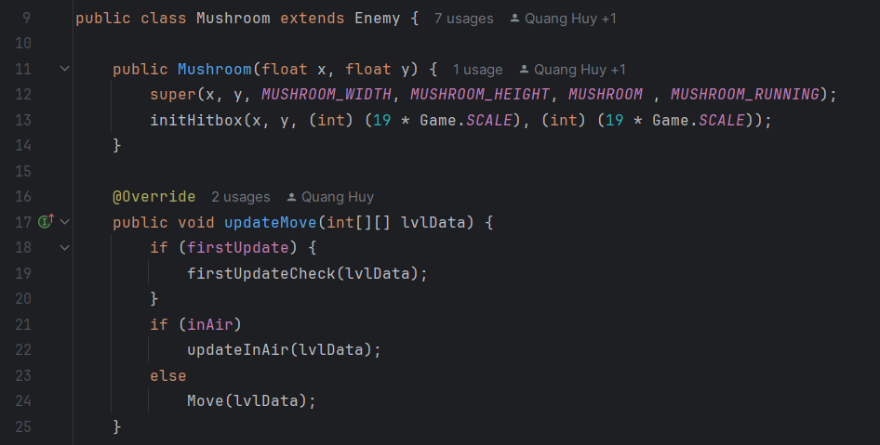
Why enemy is the abstract class?.
Class Mushroom.
firstUpdateCheck: Check whether the enemy is on the floor or not if not set inAir is true
Movement
+ If the mushroom is in the air (inAir), the updateInAir method is called, likely handling gravity or falling logic.
+ Otherwise, the Move method handles normal movement, such as walking to the player.
SUPER MARIO

Slide 25
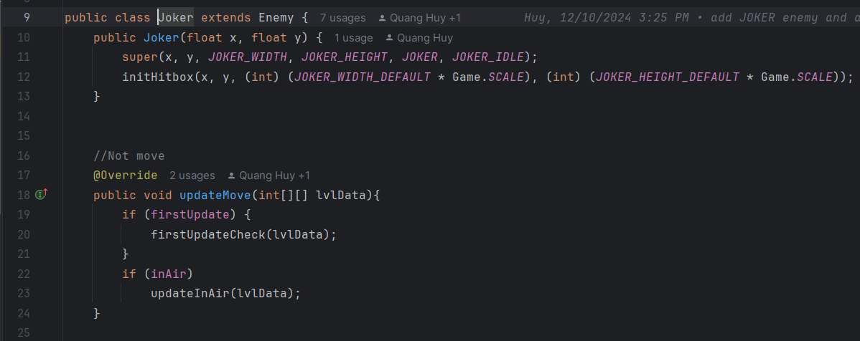
Why enemy is the abstract class?.
Class Joker
firstUpdateCheck: Runs initial setup (e.g., setting starting states)
Movement
+ If the mushroom is in the air (inAir), the updateInAir method is called, likely handling gravity or falling logic.
+ Joker doesn’t move, so it doesn’t have a move method.
SUPER MARIO

Slide 26
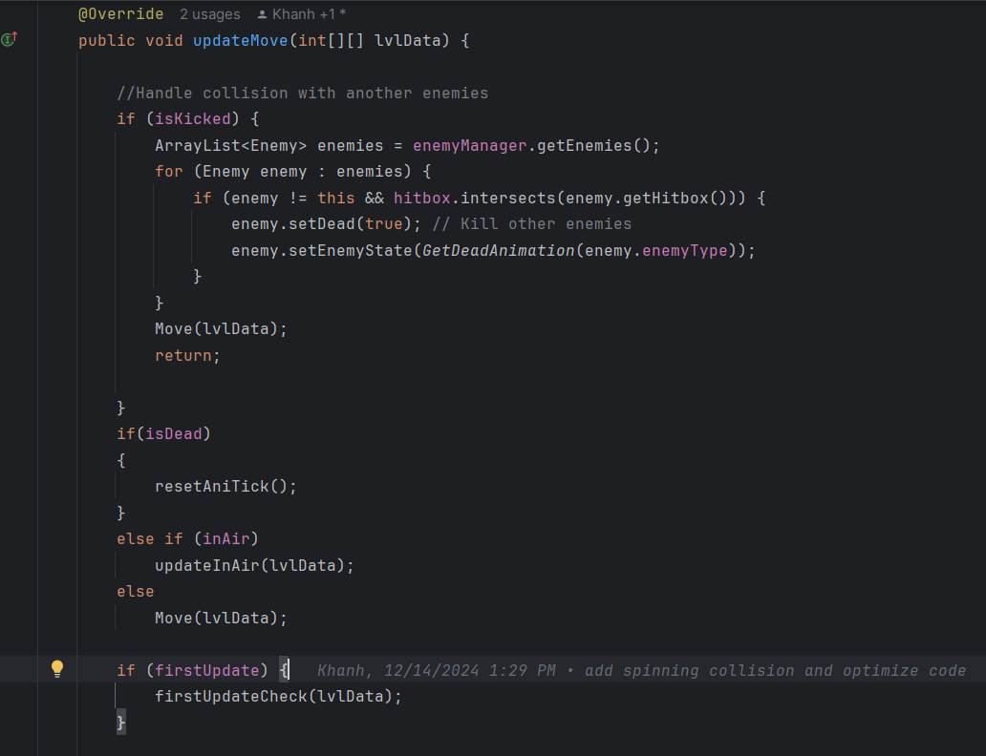
While the turtle is stunned, the player can kick the turtle shell, causing it to spin across the screen.
Why enemy is the abstract class?.
Class Turtle
The turtle's behavior shares similarities with the mushroom initially but introduces unique mechanics after its interaction with the player.
When player the collision above turtle and it will be stunned
While the turtle is stunned, the player can kick the turtle shell and flag isKicked set to true
When spinning turtle can kill player and other enemies
SUPER MARIO

Slide 27
DEMO

